Slide 1
AWARDS
101
Overview of the ACTE Awards
Basic Processes & Tips

Slide 2
ACTE’s Awards
The ACTE® Excellence Awards recognize excellence and dedication within the field of career and technical education among ACTE members. Recipients of these awards are exceptional individuals who have contributed to the success of CTE through the quality of their work and their involvement in the CTE community.
There are eight (8) Excellence Awards:
ACTE Teacher of the Year
ACTE New Teacher of the Year
ACTE Administrator of the Year
ACTE Postsecondary Teacher of the Year
ACTE Teacher Educator of the Year
ACTE Career Guidance Award
ACTE Carl Perkins Community Service Award
Information on each can be found on the ACTE Awards Portal.

Slide 3
The Nomination Process
Nominations begin at the state level; deadlines vary by state
State winners are eligible to progress onto their Region level (only one winner per category). They must be ACTE members and have their nominations submitted on the Awards Portal by March 1.
Region winners are announced at their respective conferences. Winners move forward automatically for consideration at the national level.
National winners are announced at ACTE’s CareerTech VISION.

Slide 4
The Online Process
Applicants for the Nebraska state awards who are not members of ACTE/ACTEN are able to submit a written application.
Those individuals who are members of ACTE/ACTEN are to apply for the award through the ACTE portal.
All Region award candidates must be a member of ACTE/ACTEN and submit their nominations online via the ACTE Awards Portal.
The Awards Portal automates several steps of the nomination and review process, saving award chairs time.
https://actenebraska.org/awards/
https://acte.secure-platform.com

Slide 5
Where do nominations come from?
ACTE allows self-nominations for the awards, as well as nominations from peers. For the most part, candidates are either directly nominated or encouraged to nominate by a colleague, supervisor, or peer.
States solicit nominations from:
Board of Directors
Administrators
Past award winners
Division leaders: several states charge their Divisions with putting forth a candidate in each award category. Some Divisions hold their own contests/review processes to select a candidate; others seek out a single nominee to put forward.

Slide 6
Helpful tips to access the portal and fill out the application:
ACTE Awards Portal: https://acte.secure-platform.com
Upon accessing the awards portal, you will need to login. If you are new to the site, you need to create a login and password. This login and password will allow you to login to additional sites at acteonline.org.

Slide 7
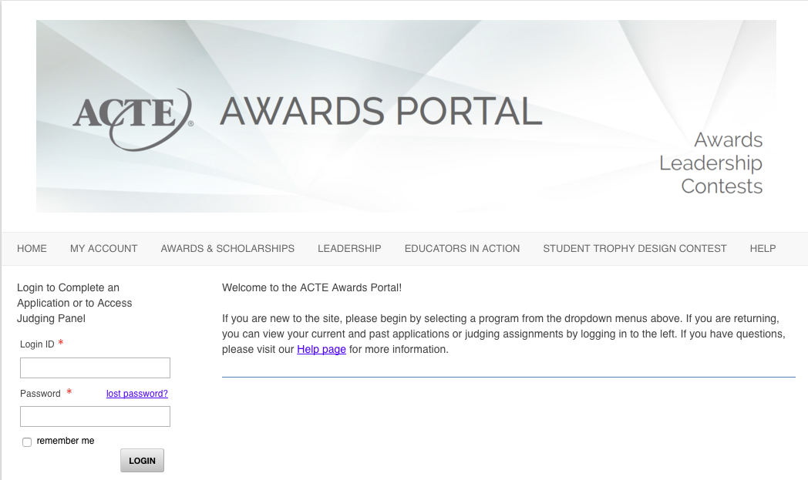
Login Page

Slide 8
Select the award category for which you are applying, or click on ‘Learn more about the Excellence Awards here’ link.
Nebraska ACTE Awards
Nebraska ACTE administers the ACTE Excellence Awards. State award winners in these categories are eligible to move forward for Region V consideration. Learn more about the Excellence Awards here.
ACTE Teacher of the Year
ACTE Administrator of the Year
ACTE Postsecondary Professional of the Year
ACTE Counseling & Career Development Professional Award
ACTE New Teacher of the Year
ACTE Teacher Educator of the Year
ACTE Carl Perkins Community Service Award
ACTE Lifetime Achievement Award
All ACTEN Awards must be submitted by March 1. If you have questions about the Nebraska ACTE Awards program, please contact Murleen Bellinger or Jean Condon. For more information and to view past winners, visit the ACTEN Awards webpage.

Slide 9
The ‘Learn more about the Excellence Awards here’ link allows you to ‘View the Guidelines’ to see what the criteria is for that award, or to start the application by clicking on ‘Submit a Nomination’.

Slide 10
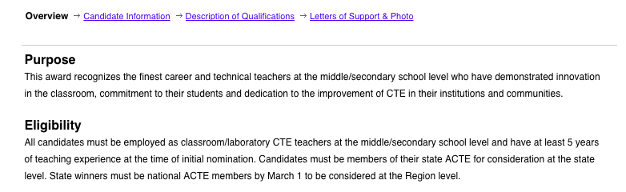
The first page of the award application is an overview of the award. Make sure you are in the category year 2027.
2027 ACTE Teacher of the Year

Slide 11
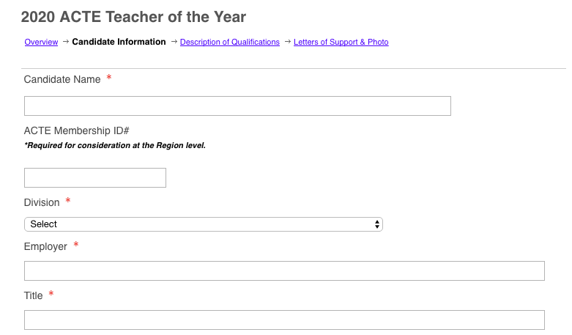
Provide the candidate information on the second page of the award application.
2027 ACTE Teacher of the Year

Slide 12
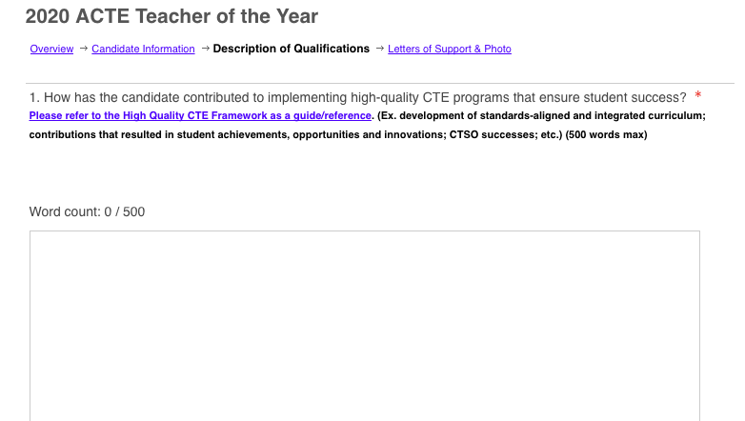
Answer the questions as instructed in the Description of Qualifications page.
2027 ACTE Teacher of the Year

Slide 13
You must have one Letter of Support and upload a photo of yourself/candidate.

Slide 14
For the state award, you will not be interviewed. However, should you continue on at the national level, you will be interviewed. The Awards Portal is used for our state, regional, and national award candidates. Once you complete the initial application, it is used for the regional and national level. You may update the award if you want.

Slide 15
You do not have to complete the award application in one sitting. You can ‘Save’ and work on it another day as long as it is completed March 1, 2027.

Slide 16
If you have questions, please contact:
Murleen Bellinger
actenebraska@gmail.com
402-480-9577

